Slide 1
Title Proposal for Practical Research 1 and 2
Marc Philip A. Landicho
Althea I. Redado
Rianer Justin O. Namuco
Ivan Alex D. Recinto
Zcherheine A. Torrefranca
Presenters

Slide 2
QUIEAZY: FUN, EASY TO USE LIVE WIFILESS QUIZ MAKER APPLICATION
General Objective
  Evaluate the creation of an alternative fun, and easy to use quiz maker application that can run offline live.
Specific Objectives
  Reduce data consumption with quiz applications.
  Increase accessibility to learners and educators.
  Increase work and learning efficiency.

Slide 3
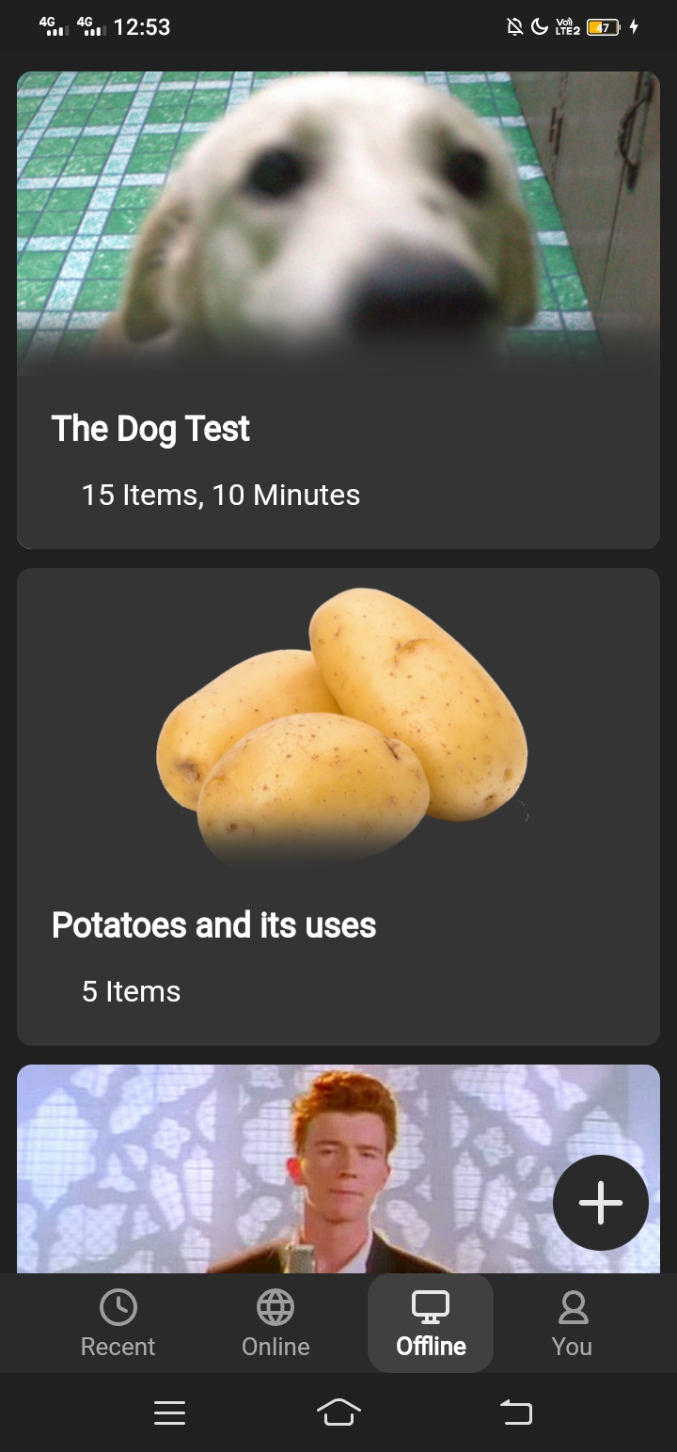
Prototype Model
Though this is made in code, it is still not final.
Made for demonstrations only.

Slide 4
PLASTIC BOTTLE AS ALTERNATIVE PARTICLE BOARD
General Objective
  Effectiveness of plastic bottles as an alternative particle board for environmental cleanliness.
Specific Objectives
  Reduce pollution in the environment.
  Reduce the mass cutting of trees.
  Improve the usage of recyclable materials.

Slide 5
DRAGON FRUIT (Selenicereus undatus) PEELS AS CHALK PIGMENT
General Objective
  Potential of dragon fruit (Selenicereus undatus) peels as chalk pigment.
Specific Objectives
  Give purpose to dragon fruit peels other than being a fertilizer.
  Produce an organic color pigment for chalks.
  Enhance the usability of dragon fruit peels.

Slide 6
Thank you!

